Slide 1

認識我
An Smart Automatic Door Lock and Visitor Management System Using Deep Learning
黃潔金/柳譯筑/吳思葶

Slide 2

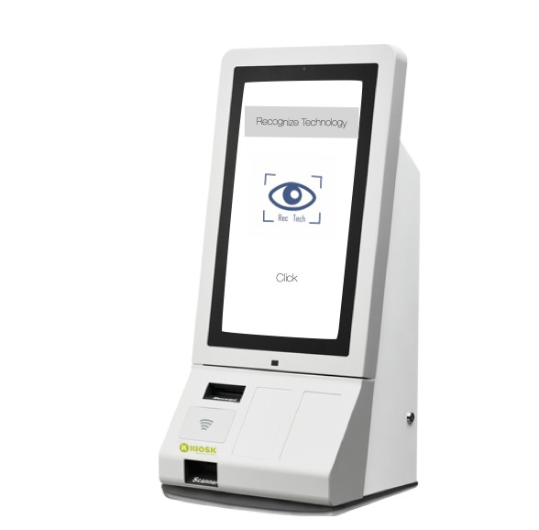
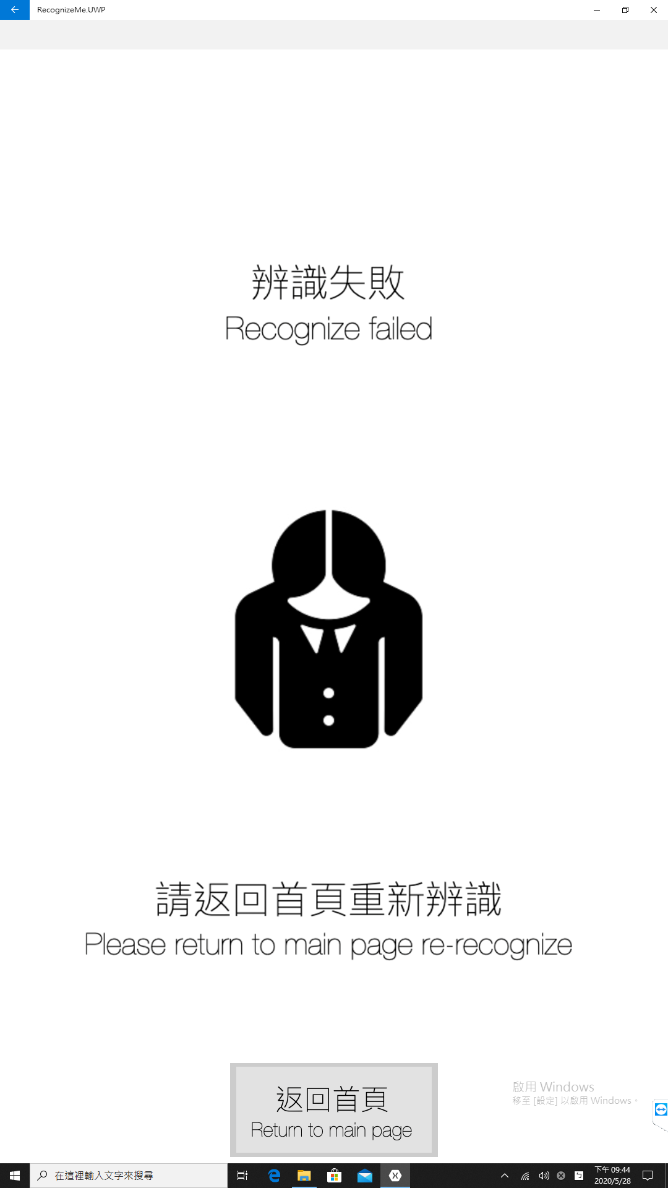


Initially…
Recognize Failed

Slide 3
To let KIOSK to recognize!

Slide 4

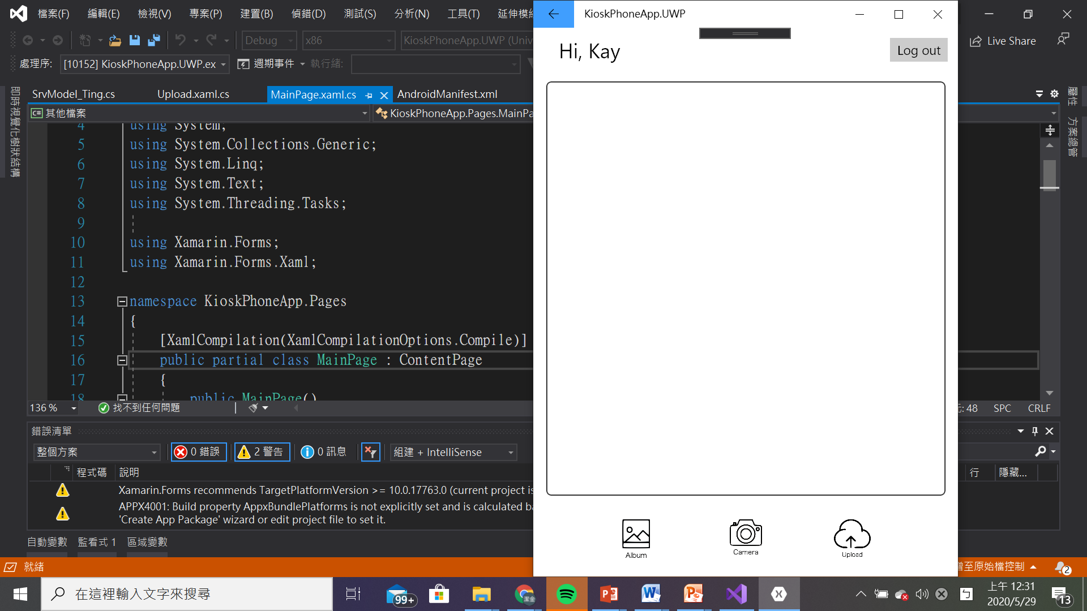
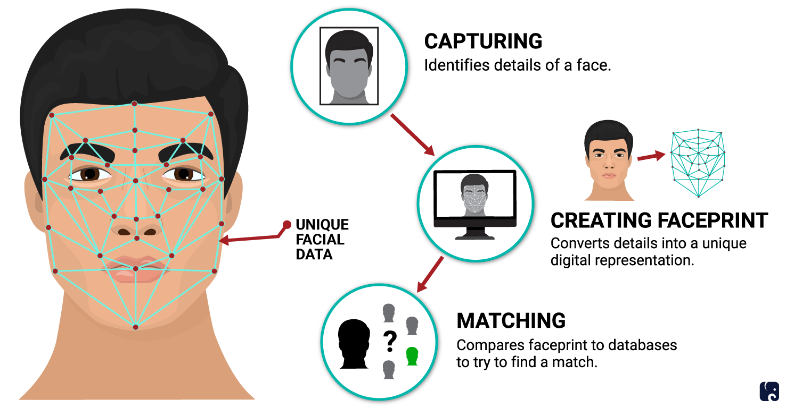

upload photo to train.
TRAIN

Slide 5
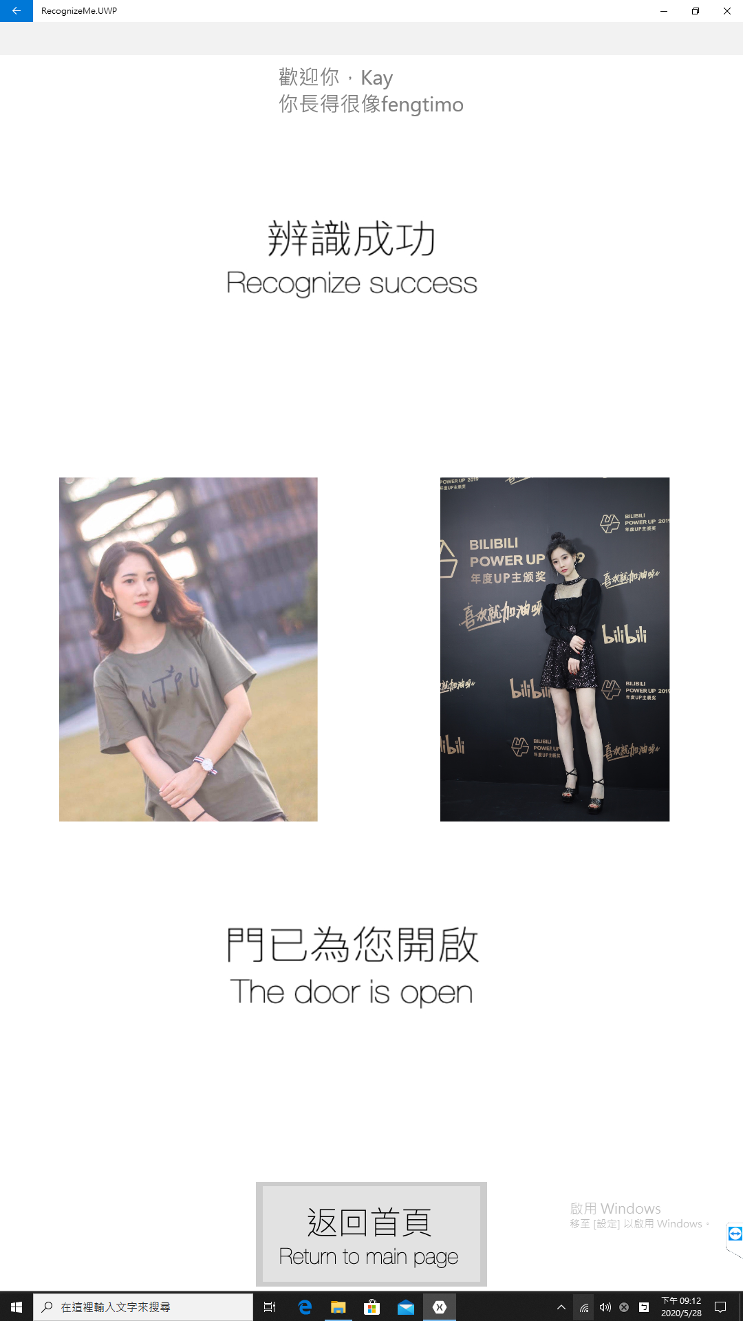
Finally…
Door Open!
Recognize Success!

Slide 6



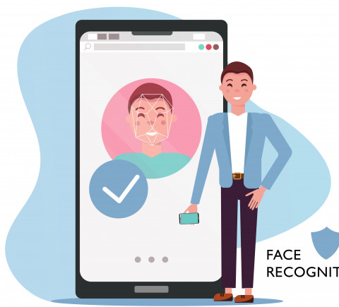
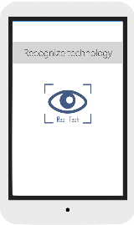



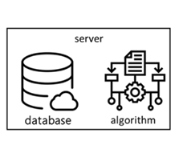
System Scenario
認識我
Upload Images
AI computation
Door management
APP
server
android
database
algorithm
kiosk
Door unlocked

Slide 7
Upload Images
認識我
Upload Images
AI computation
Door management
APP
server
android
database
algorithm
kiosk
Door unlocked

Slide 8
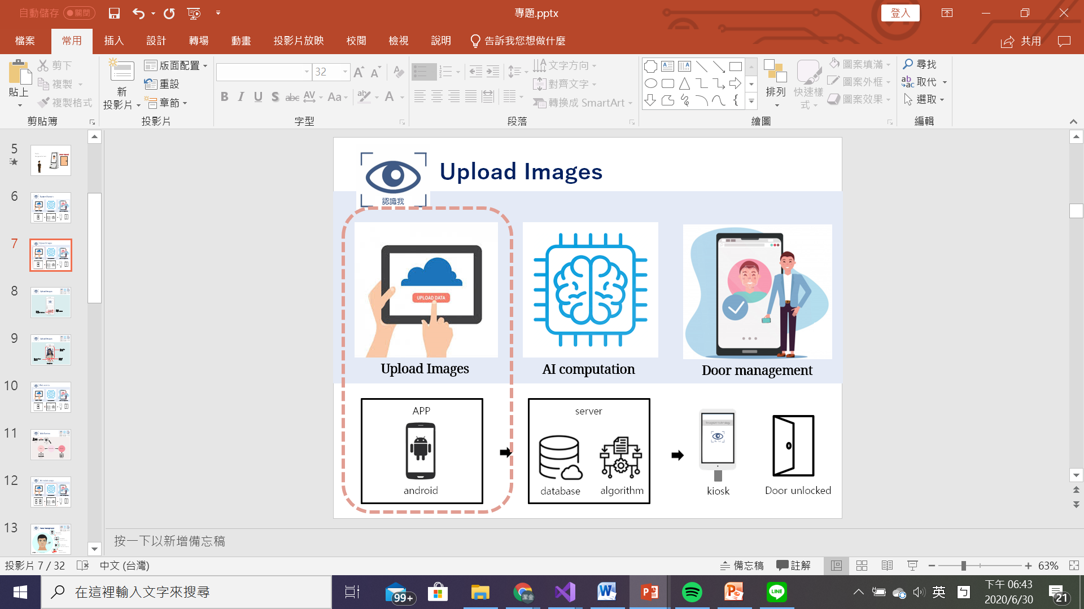
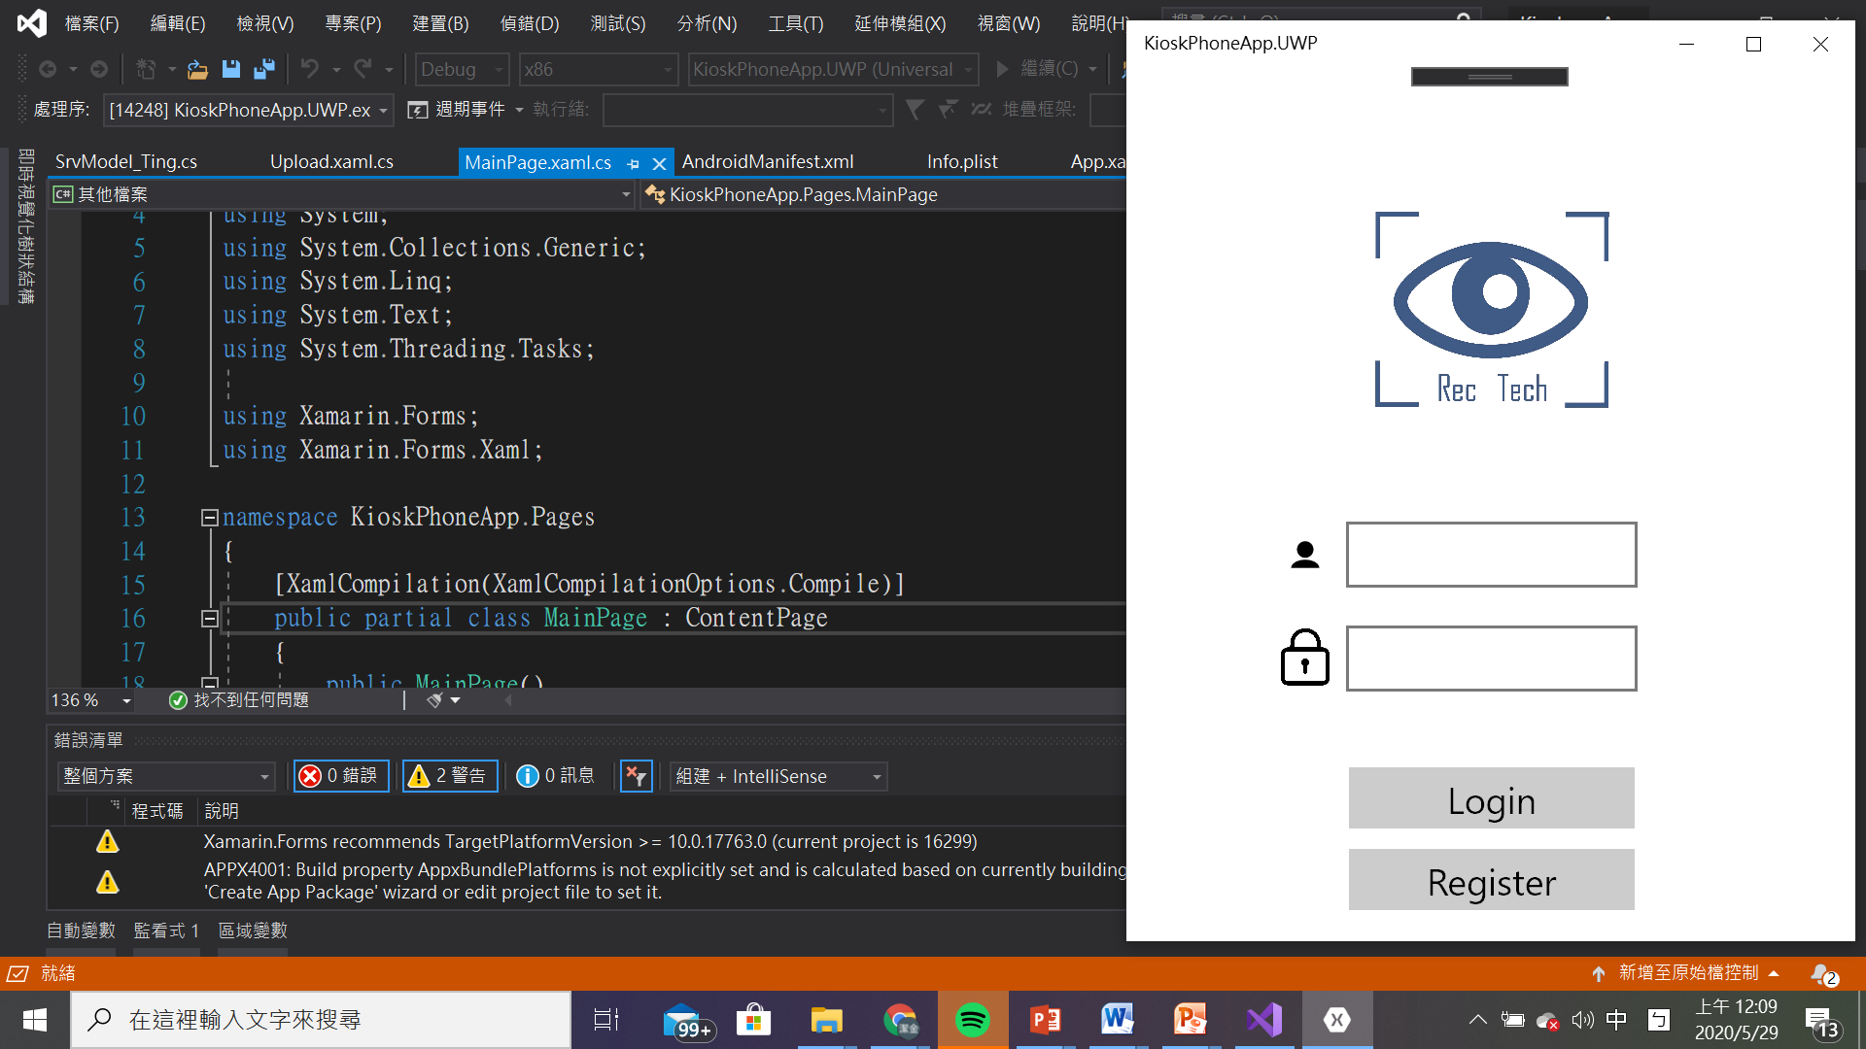
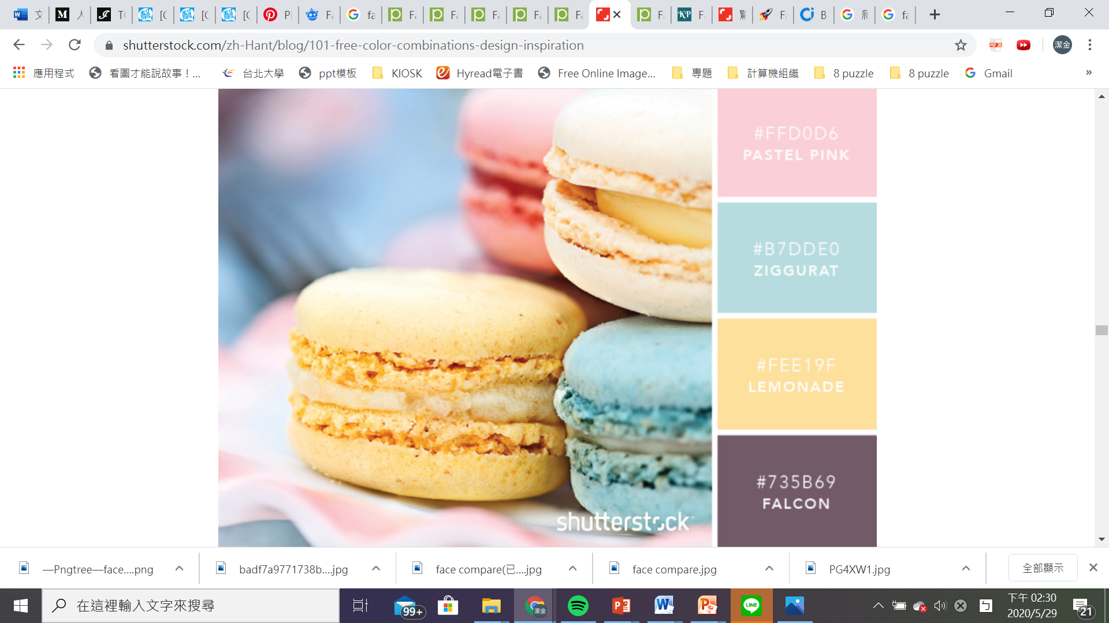
Upload Images
認識我
Press
Login button
Press
Register button

Slide 9
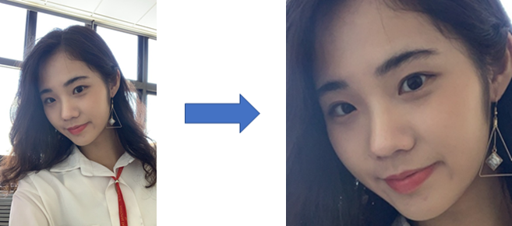
Upload Images
認識我
Show the photo
Choose from album
Upload image
take photo

Slide 10
AI module usage
認識我
Upload Images
AI computation
Door management
APP
server
android
database
algorithm
kiosk
Door unlocked

Slide 11
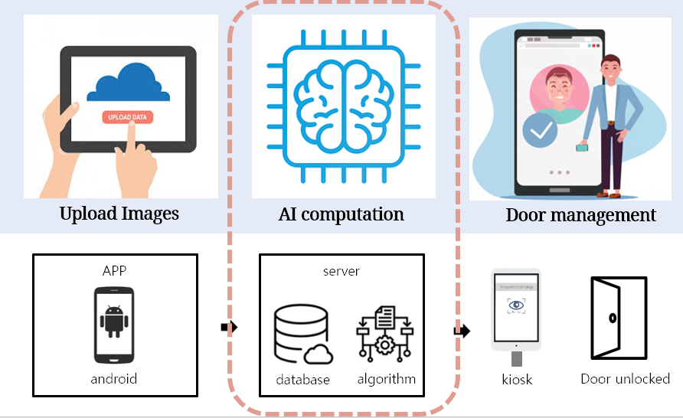
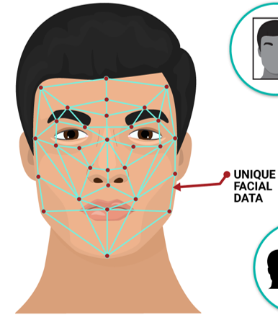
Face Recognition
認識我
One shot learning
feature extracting
參考資料 : Dlib, Facenet model

Slide 12
Face Recognition
認識我
CAPTURING
Dlib: detector
EXTRATING
Facenet: encoding
COMPARING
Triple loss: comparing
MATCHING
參考資料 : Dlib, FaceNet model
IDENTIFIED
Compare distance

Slide 13




Face Recognition
認識我
CAPTURING
EXTRATING
COMPARING
MATCHING
參考資料 : Dlib, FaceNet model
Face detection

Slide 14
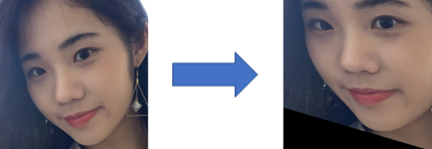
Face Recognition
認識我
CAPTURING
EXTRATING
COMPARING
MATCHING
參考資料 : Dlib, FaceNet model
Face alignment

Slide 15
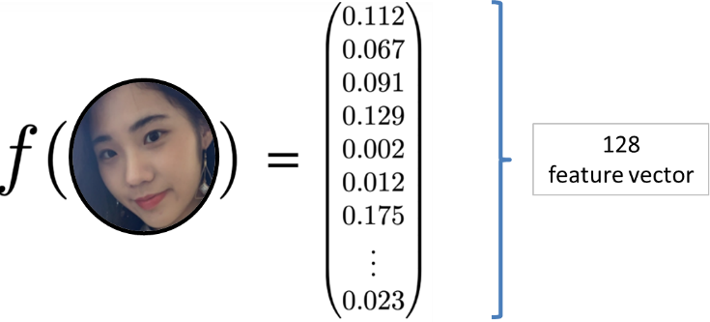
Face Recognition
認識我
CAPTURING
EXTRATING
COMPARING
MATCHING
參考資料 : Dlib, FaceNet model
Face featuring

Slide 16
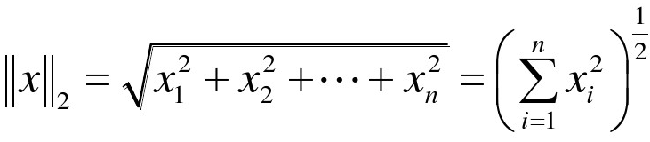
Face Recognition
認識我
CAPTURING
EXTRATING
COMPARING
MATCHING
Euclidean norm
參考資料 : Dlib, FaceNet model

Slide 17
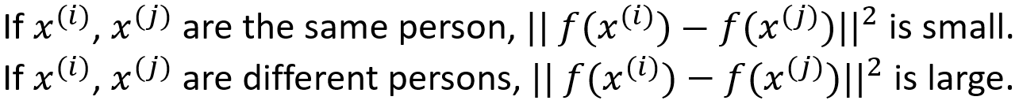
Face Recognition
認識我
CAPTURING
EXTRATING
COMPARING
MATCHING
matching function
參考資料 : Dlib, FaceNet model

Slide 18
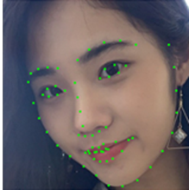
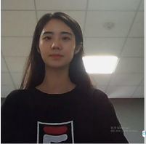
Face Recognition
認識我
CAPTURING
EXTRATING
COMPARING
MATCHING
MATCHING
Result analyzing
參考資料 : Dlib, FaceNet model

Slide 19

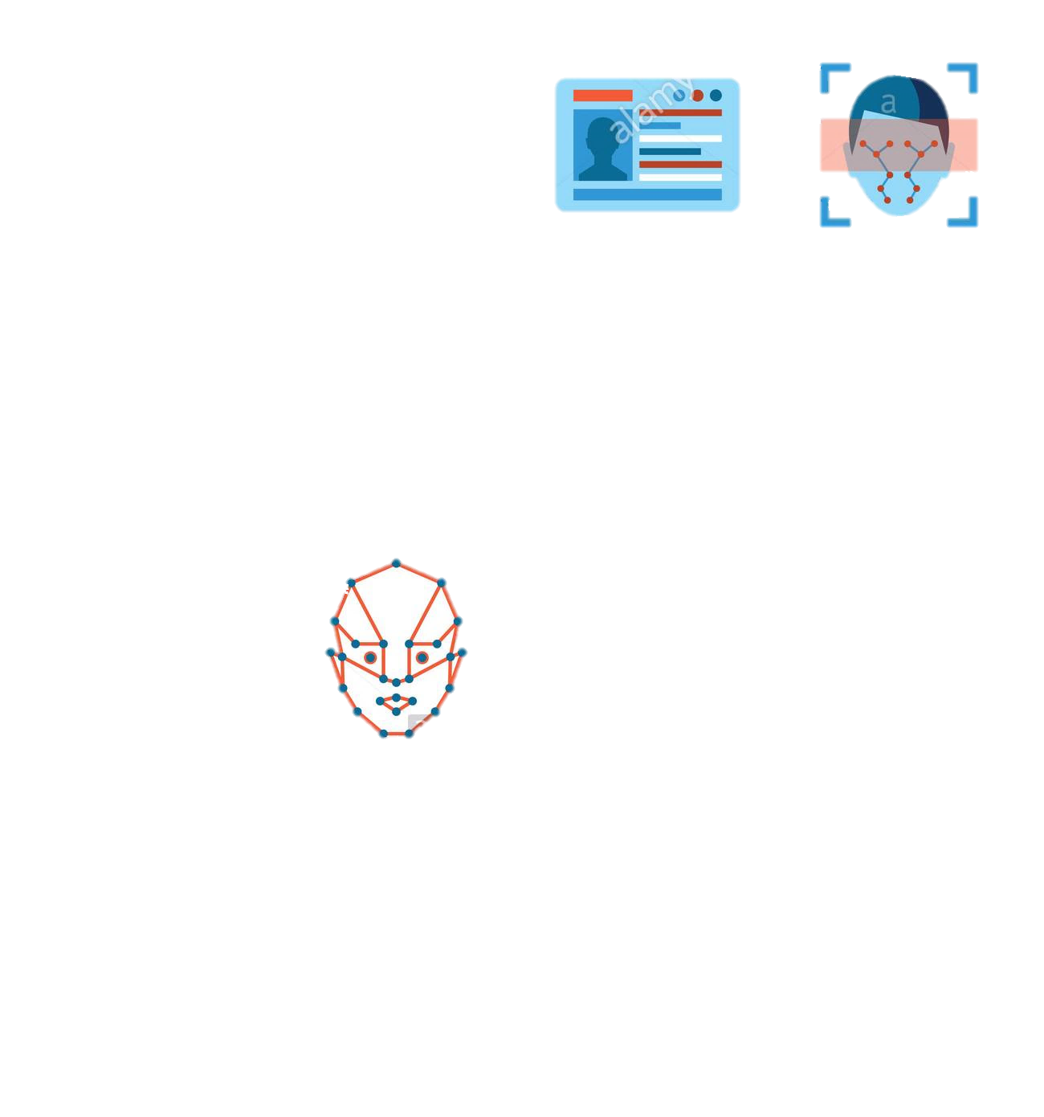

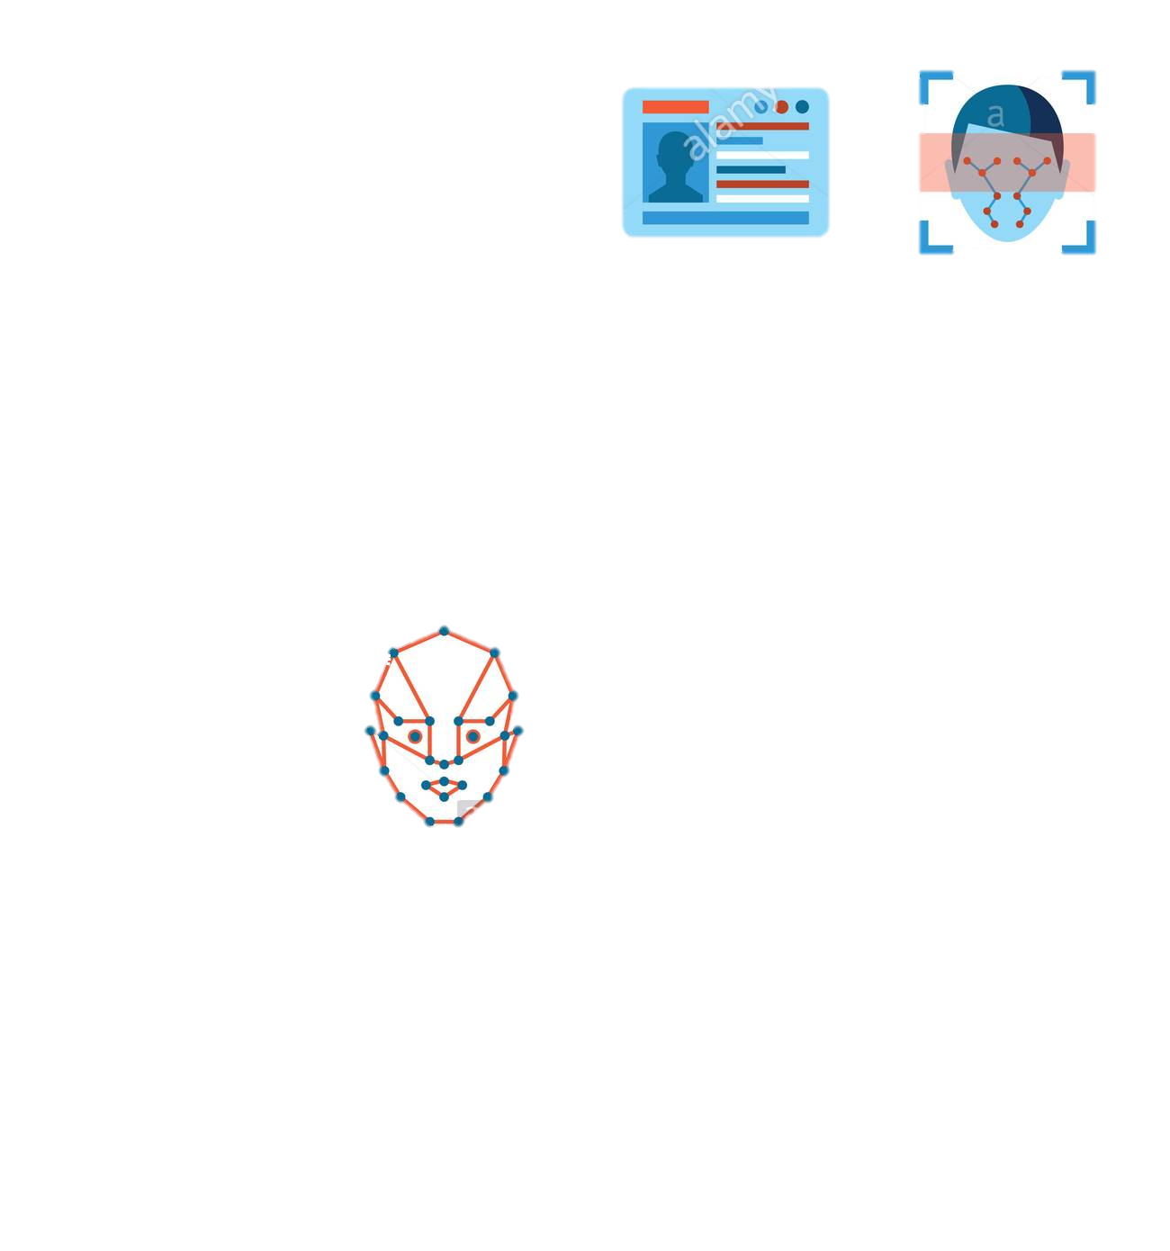


Celebrity Detection
認識我
WEB CRAWLER
BeautifulSoup
COUNTING
Haar Cascades
EXTRATING
User photo
Star photo
Dlib encoding
MATCHING
SUCCESS
Most similar

Slide 20
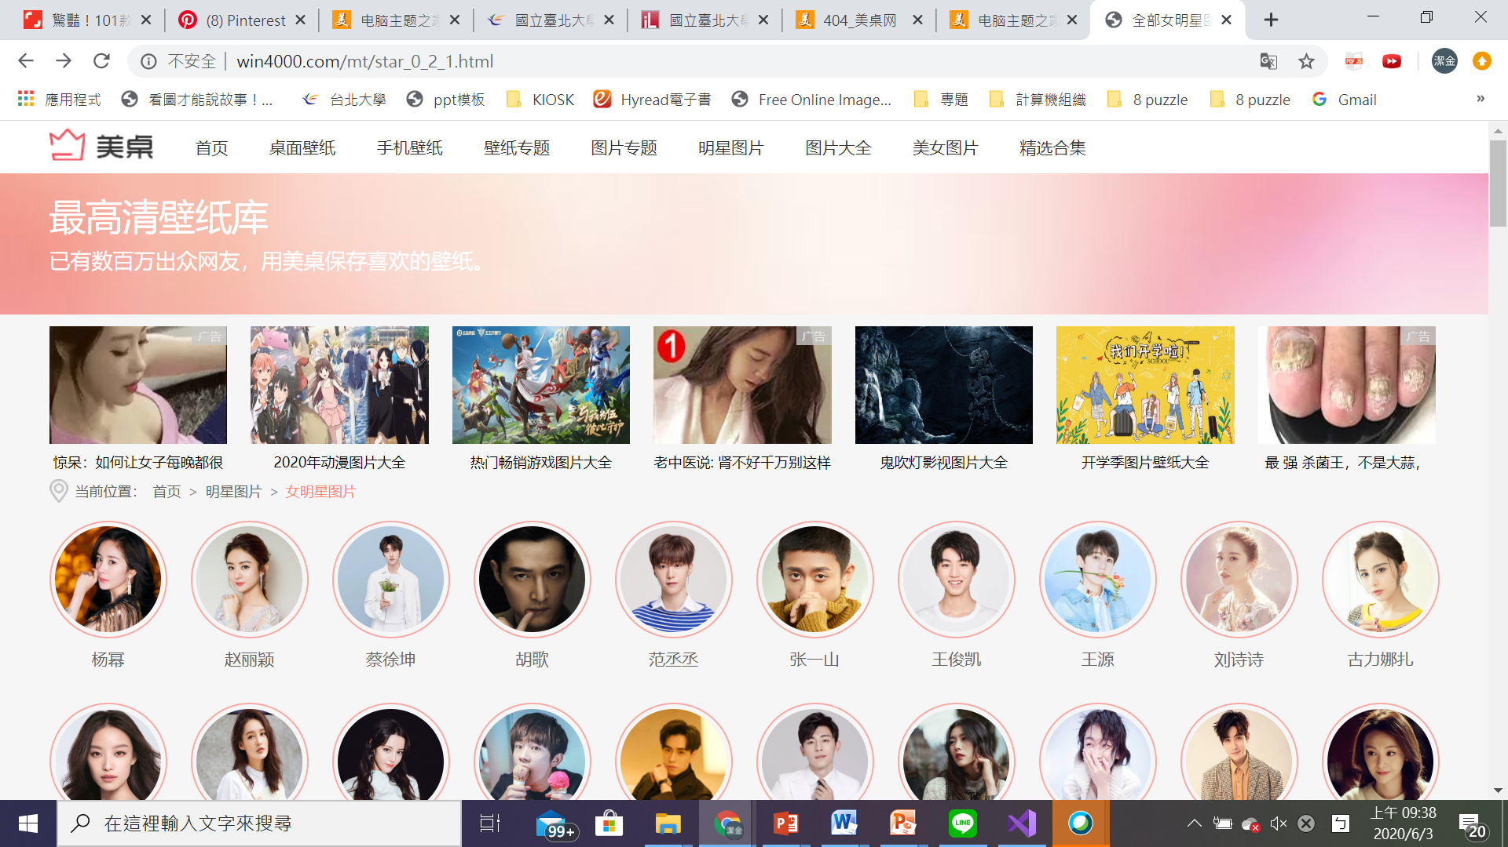
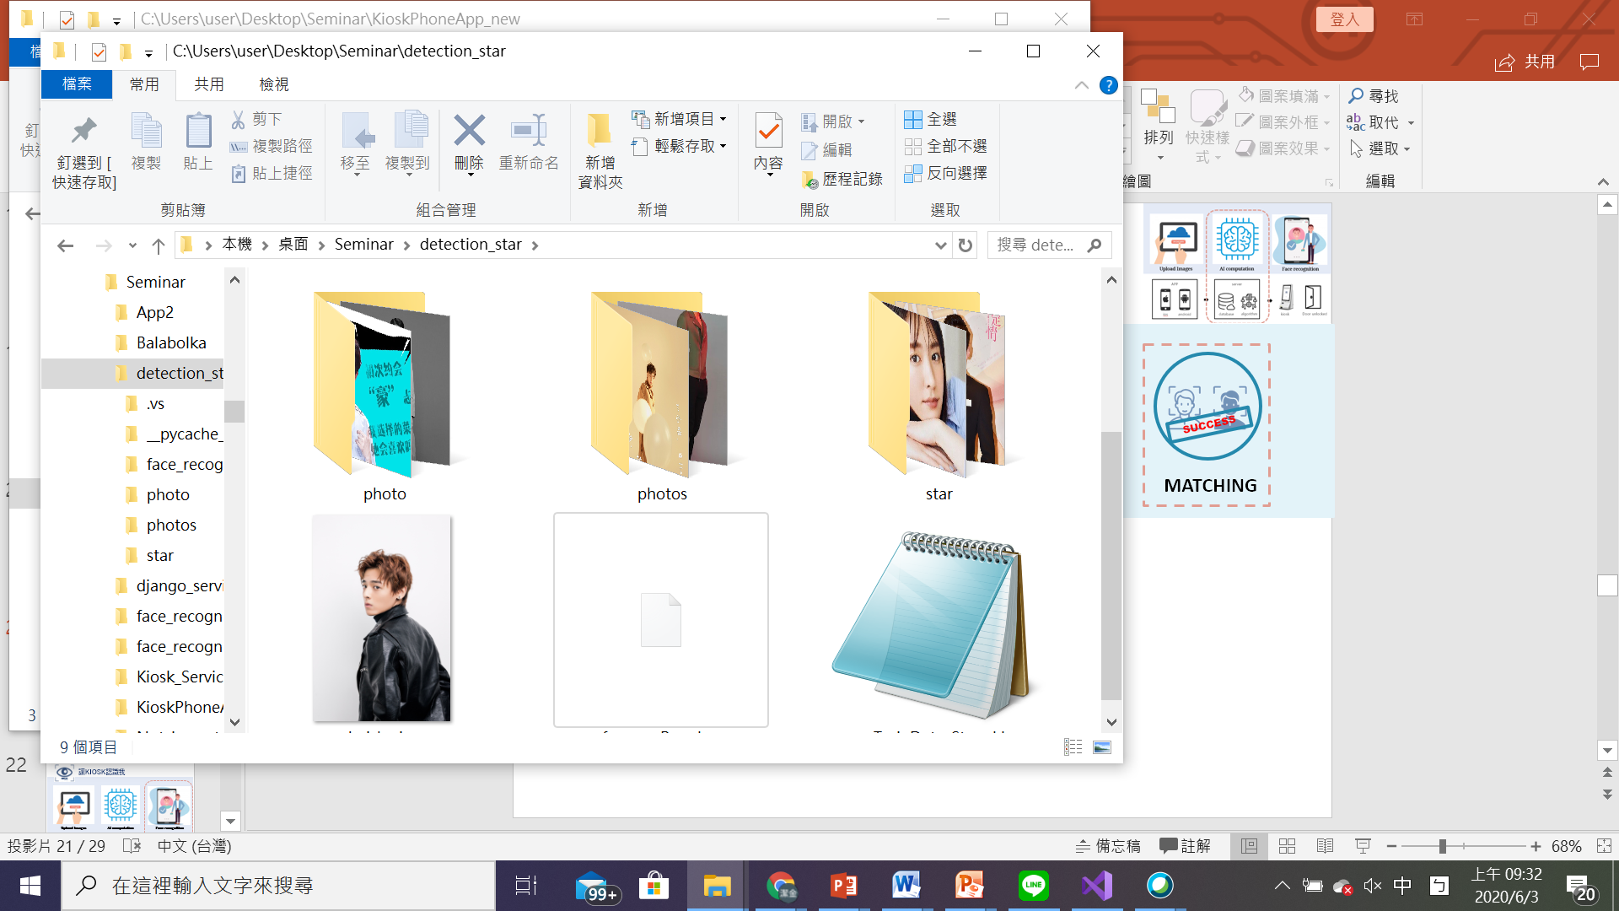
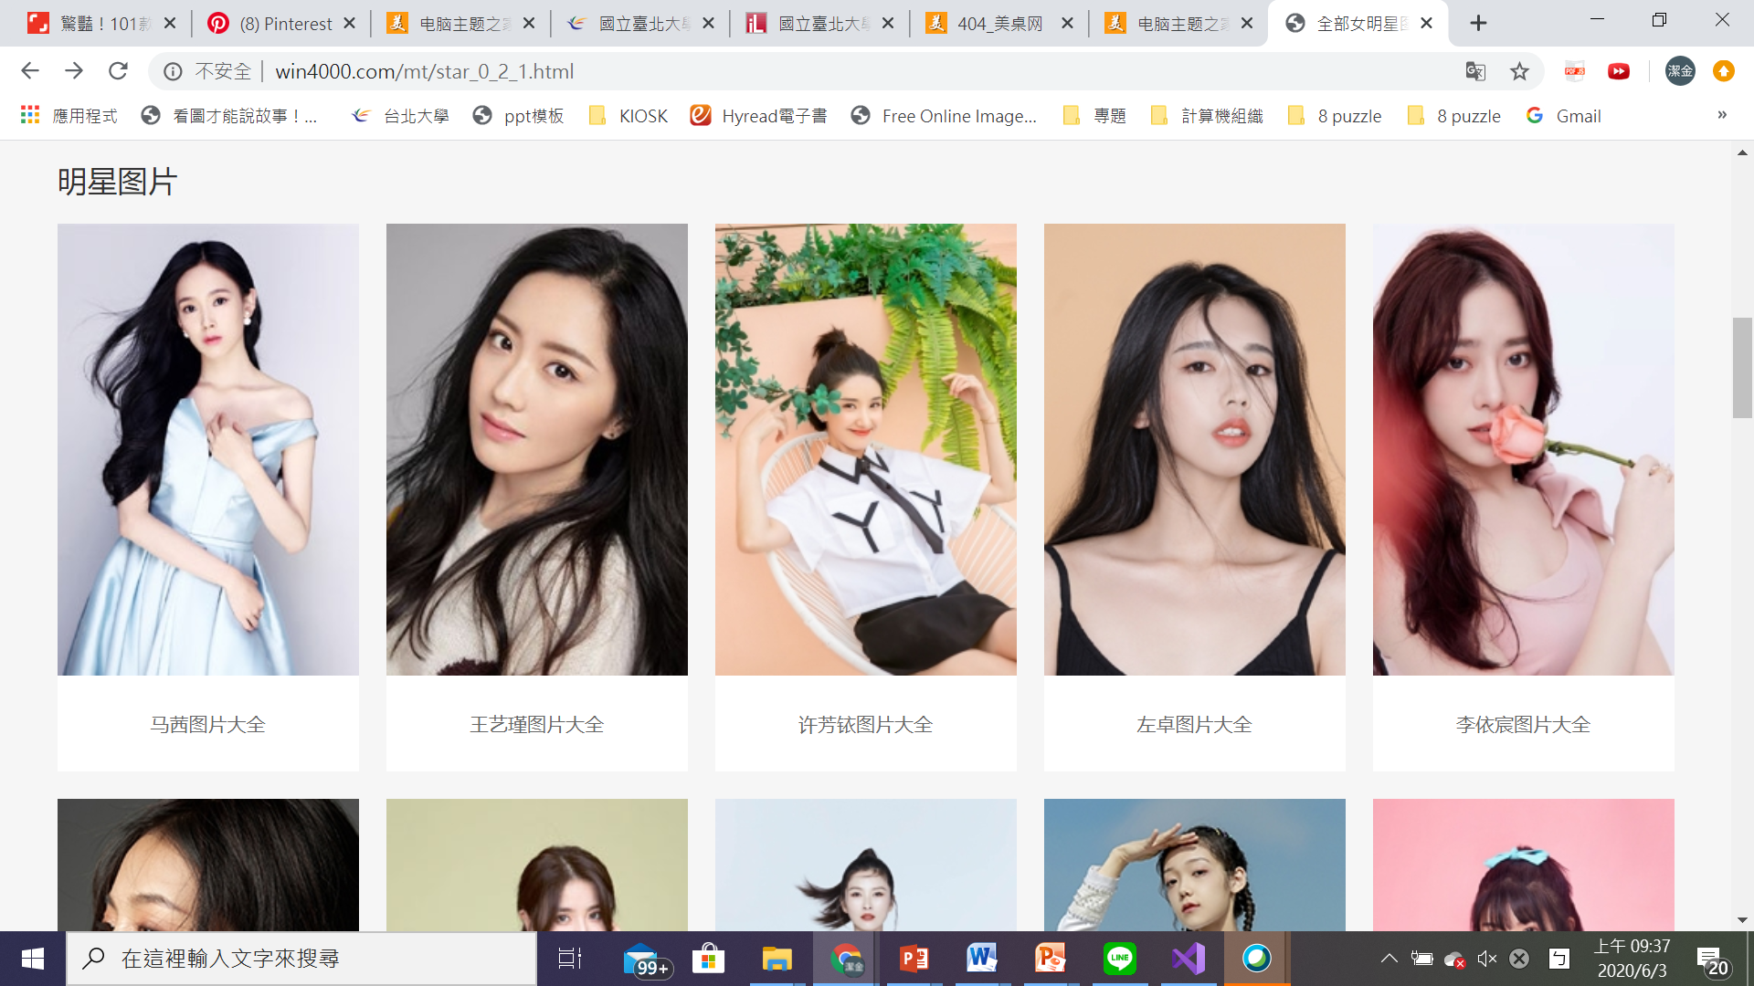
Celebrity Detection
認識我
SUCCESS
WEB CRAWLER
COUNTING
EXTRATING
MATCHING
BeautifulSoup
數量:
共300個
網頁爬取資料

Slide 21


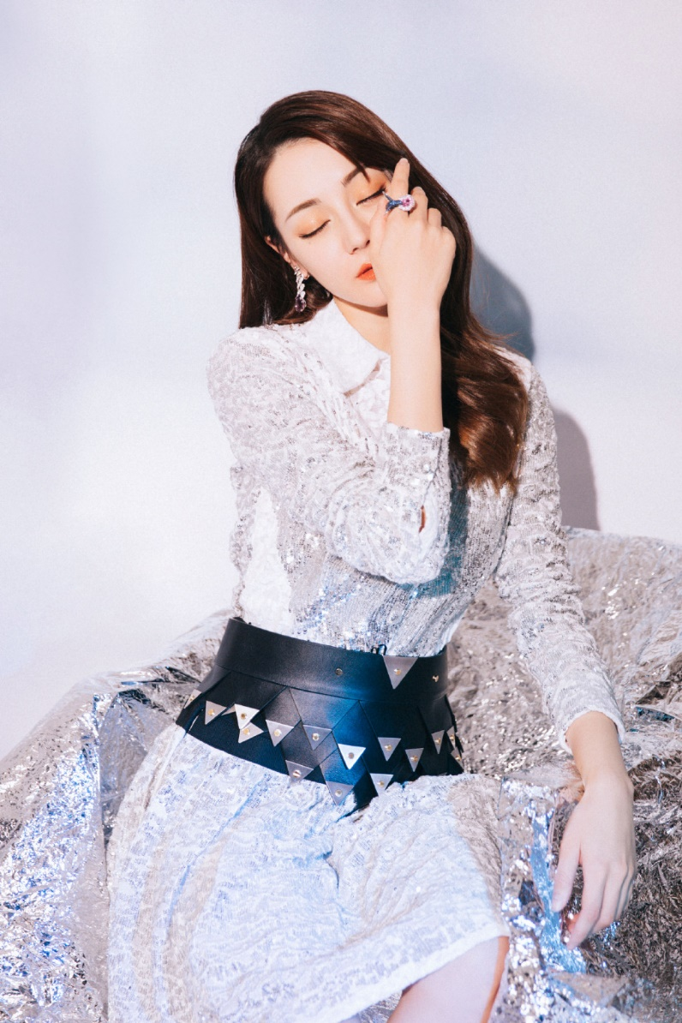


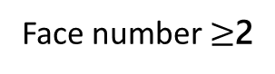
Celebrity Detection
認識我
SUCCESS
WEB CRAWLER
COUNTING
EXTRATING
MATCHING
Face number = 1
Face number $≥$2
Face number = 0

Slide 22
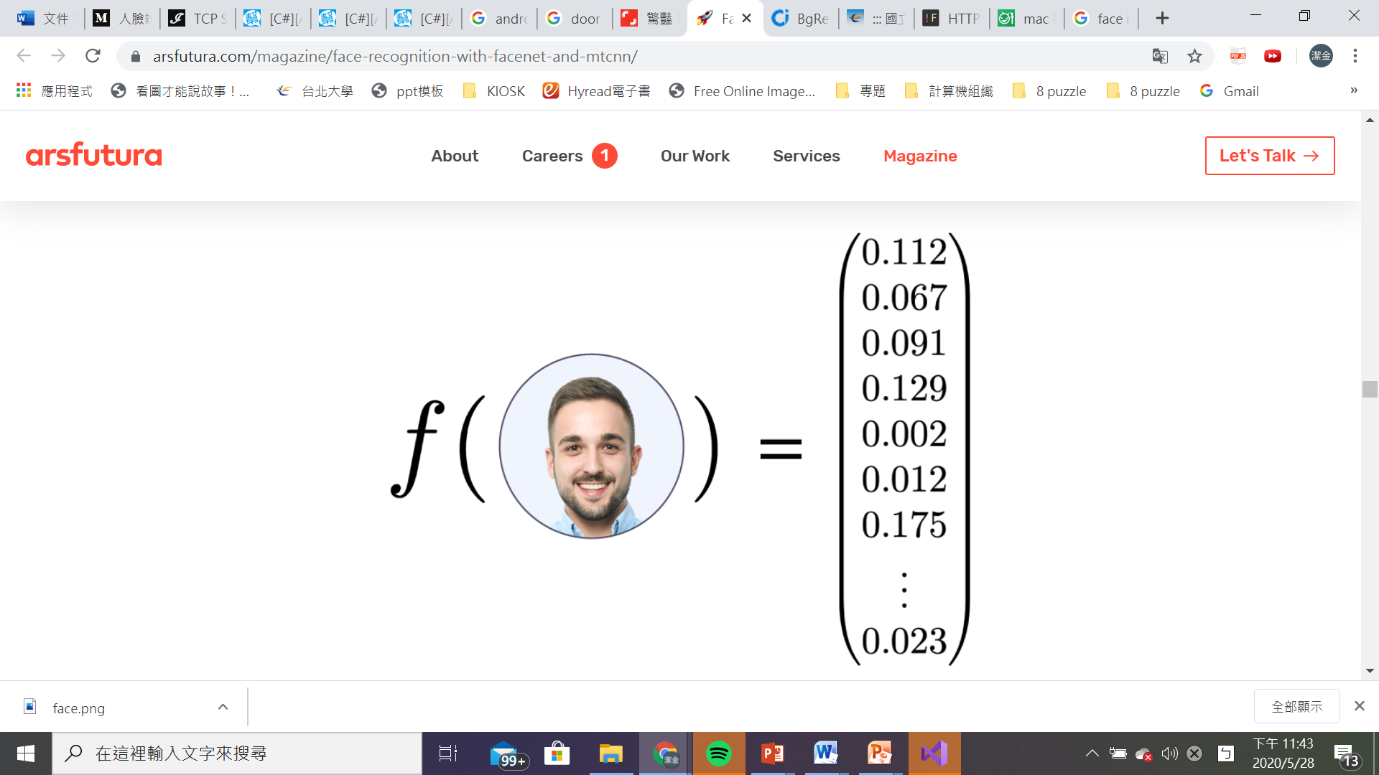


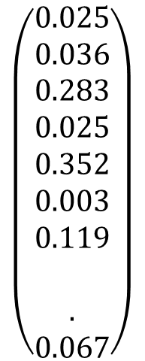


Celebrity Detection
認識我
SUCCESS
WEB CRAWLER
COUNTING
EXTRATING
MATCHING
$$\left(\begin{aligned}0.025 \\ 0.036 \\ 0.283 \\ 0.025 \\ 0.352 \\ 0.003 \\ 0.119 \\ \\ . \\ 0.067\end{aligned}\right)$$
User: $x^{(i)}$
Star: $x^{(j)}$

Slide 23
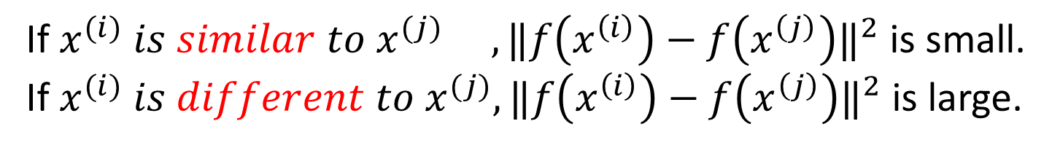
Celebrity Detection
認識我
SUCCESS
WEB CRAWLER
COUNTING
EXTRATING
MATCHING
If $x^{(i)} is similar to x^{(j)}{ , ‖f\left(x^{\left(i\right)}\right)−f\left(x^{\left(j\right)}\right)‖}^{2}$ is small.
If $x^{(i)} is different to x^{(j)}, {‖f\left(x^{\left(i\right)}\right)−f\left(x^{\left(j\right)}\right)‖}^{2}$ is large.
matching function

Slide 24


Celebrity Detection
認識我
SUCCESS
WEB CRAWLER
COUNTING
EXTRATING
MATCHING
MATCHING
Result analyzing

Slide 25
Web service
認識我
Upload Images
AI computation
Door management
APP
server
android
database
algorithm
kiosk
Door unlocked

Slide 26



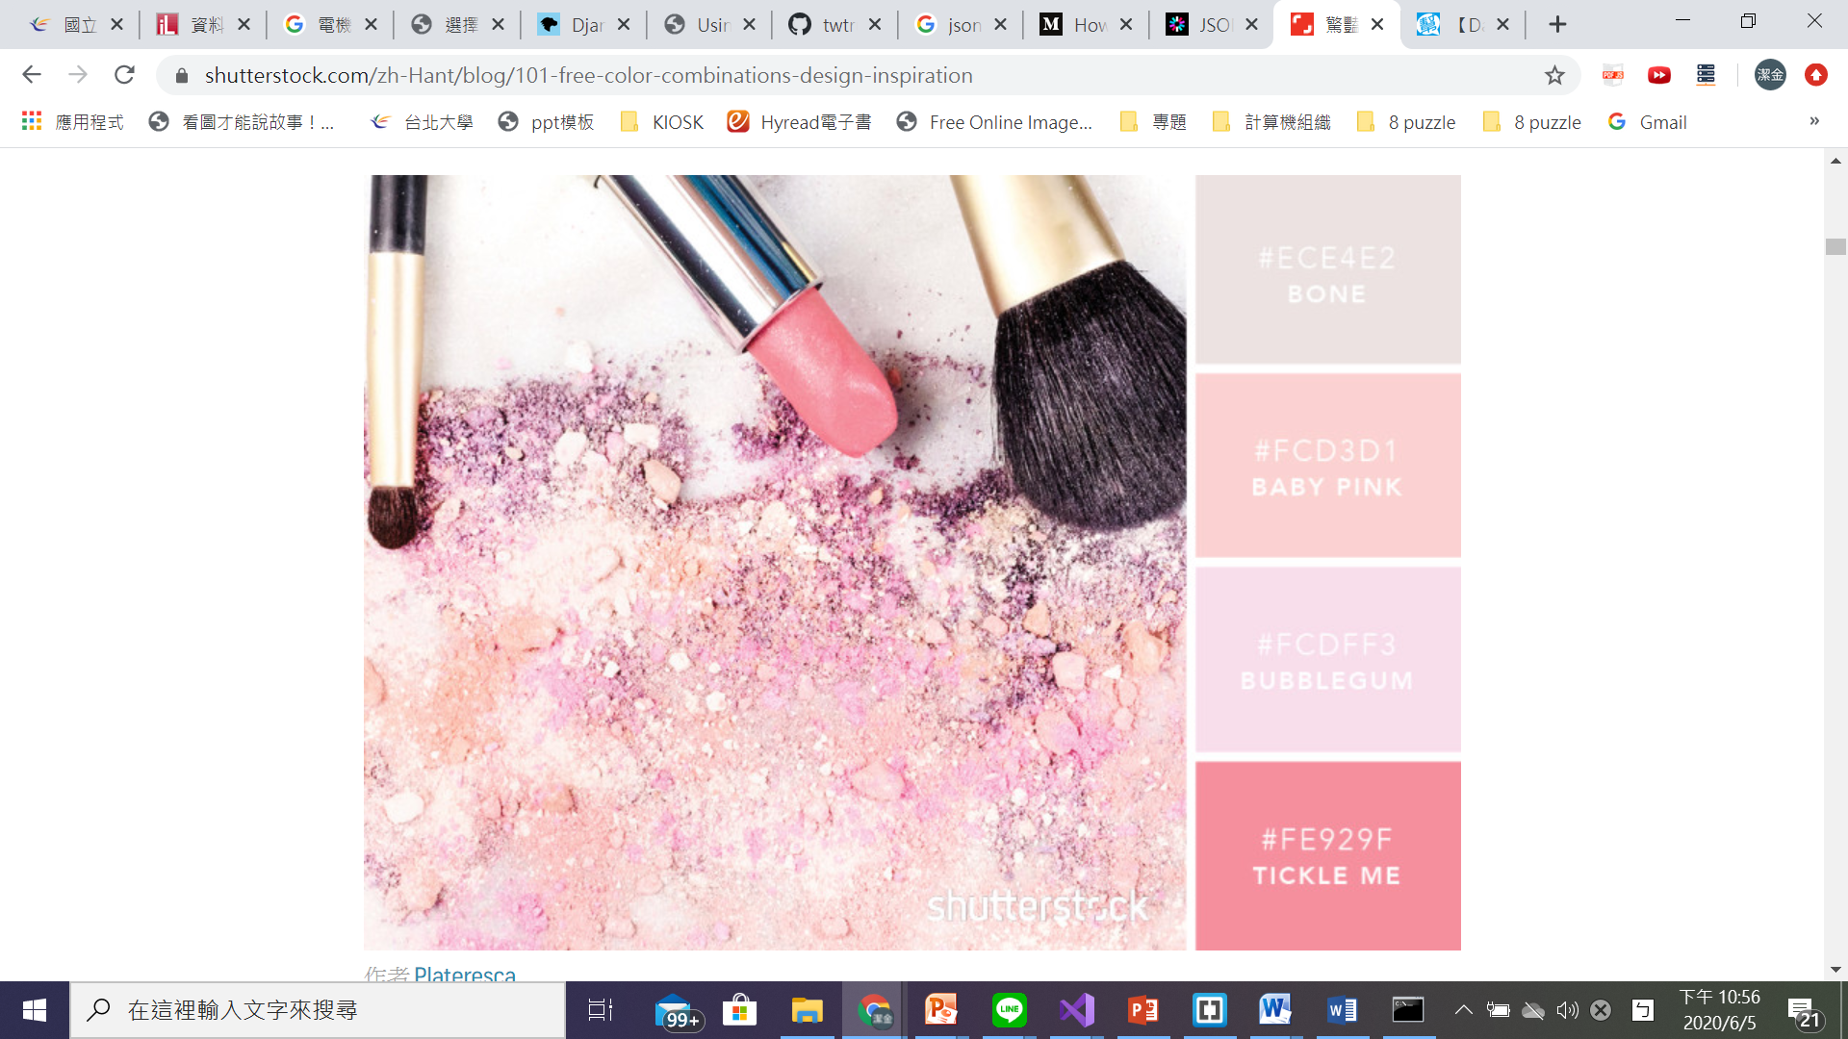


Web Service
認識我
http
Client
Web server
(IIS)
Controller
Controller
View
Model
Browser
Database

Slide 27
Door management
認識我
Upload Images
AI computation
Door management
APP
server
android
database
algorithm
kiosk
Door unlocked

Slide 28

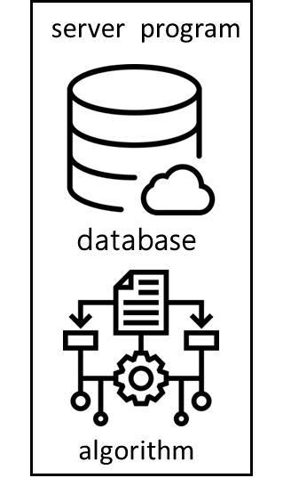
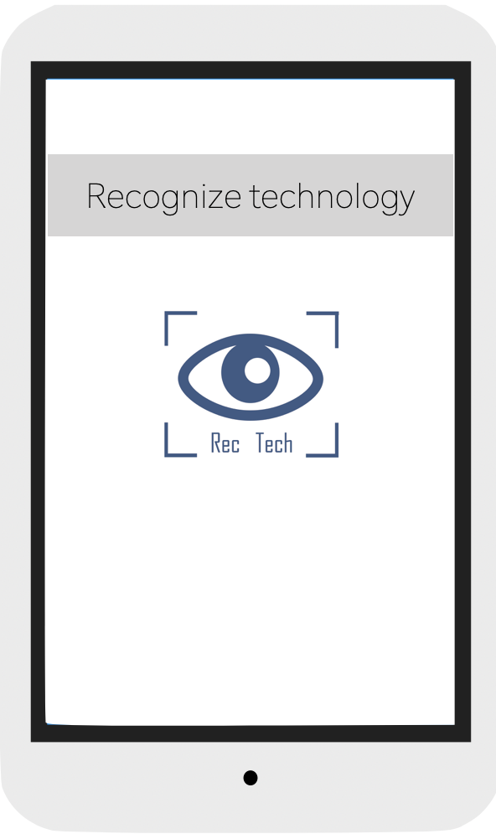
Door Management
認識我
Call API
KIOSK

Slide 29
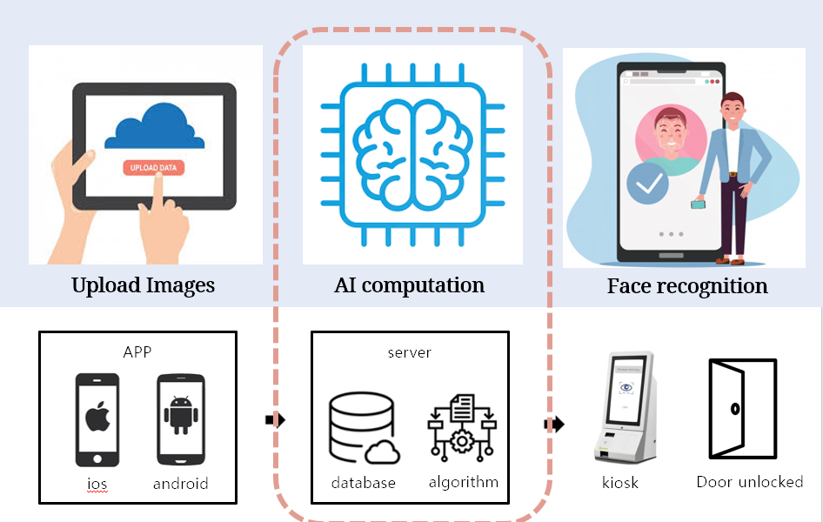

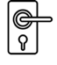
Door Management
認識我
Socket
Raspberry Pi
result
Open door
command
Electronic lock
KIOSK

Slide 30
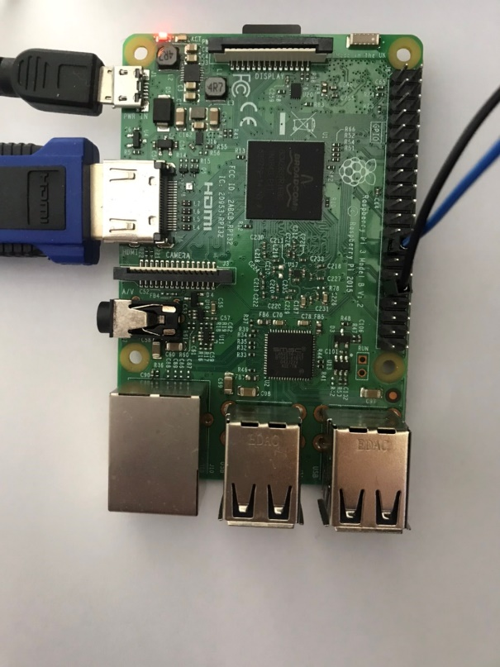
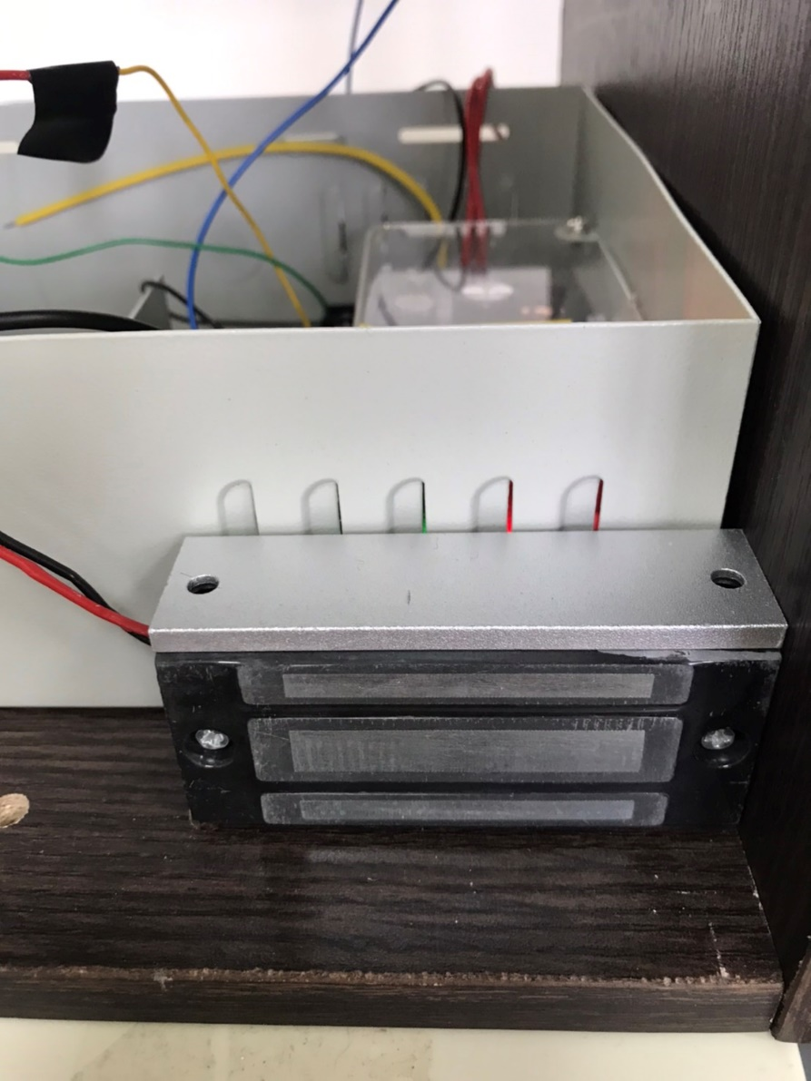
Door Management
認識我
Raspberry Pi
Electronic lock

Slide 31
Door Management
認識我
KIOSK
Start face recognition

Slide 32
Result Failed
認識我
KIOSK
Door locked
Click to
re-recognize

Slide 33
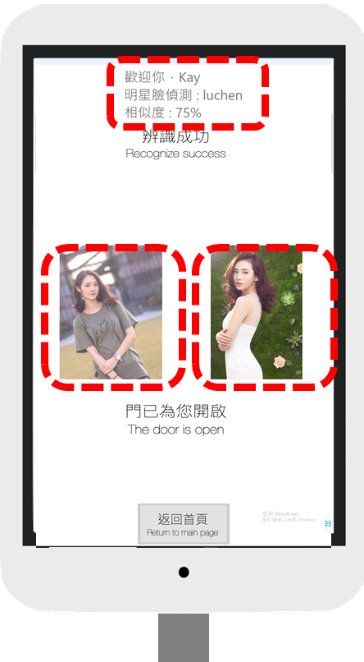
Result Success
認識我
KIOSK
Door unlock
User name
& Star name
User Photo
Star Photo

Slide 34
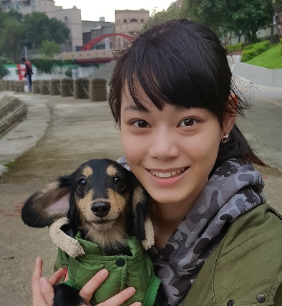

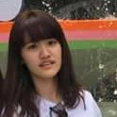
認識我
吳思葶
柳譯筑
黃潔金

